Slide 1
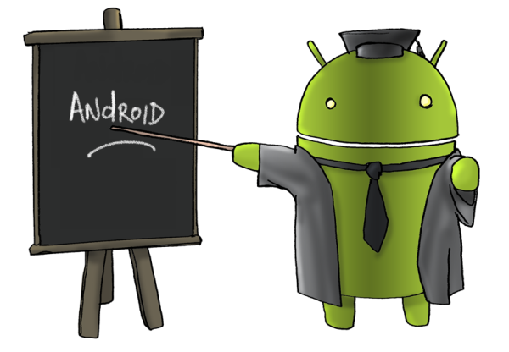
Android Overview
Eng. Basma Hassan
Eng. Samar Shaban

Slide 2
Course Lab Outline
Teaching Assistants:
Eng.Basma
bhassan@fayoum.edu.eg
Mobile: 0111 406 4844
Office hours: Tuesday and Thursday 1.00 – 3.00 p.m
Eng.Samar
Text Book:
“OpenGL ES 2 for Android: A Quick-Start Guide, by Kevin Brothaler”
Assessment Method:
Course project (Groups)

Slide 3
Course Lab Schedule Plan
Week 1 : Introduction to Android Development
Week 2 : Simple Android Application
Week 3 : OpenGL ES – Getting Started
Week 4 : 2D Transformation
Week 5 : Entering the 3D
Week 6 : Camera Position
Week 8 : Lighting
Week 9 : Texture Week 10 : Building Objects
Week 11 : Touch Feedback
Week 12-13: Project Follow-up and Support

Slide 4
Android Development

Slide 5
Why Mobile App Development?
Mobile platform is the platform of the future
Job market is hot
Market for mobile software surges from $4.1 billion in 2009 to $17.5 billion by 2012
2010 Dice.com survey: 72% of recruiters looking for iPhone app developers, 60% for Android
Dice.com: mobile app developers made $85,000 in 2010 and salaries expected to rise
Students (and faculty!) are naturally interested!

Slide 6
Mobile Devices: Advantages
Always with the user
Typically have Internet access
Typically GPS enabled
Typically have accelerometer & compass
Most have cameras & microphones
Many apps are free or low-cost
Notes:
Maybe more profitable with ads than actually selling the app

Slide 7
Mobile Devices: Disadvantages
Limited screen size
Limited battery life
Limited processor speed
Limited and sometimes slow network access
Limited or awkward input: soft keyboard, phone keypad, touch screen, or stylus
Limited web browser functionality

Slide 8
Why Android?
A lot of students have them
Students already know Java and Eclipse
Low learning curve
Transferring app to phone is trivial
Can distribute by putting it on the web
Android Market (now Google Play) for wider distribution
Open source
Free cost development

Slide 9
Types of Android Devices
Various Android Phones
Tablets
Android-Powered:
Microwave
Watch
Camera
TV
Washing Machine

Slide 10
Brief History - Android
2005
Google acquires startup Android Inc. to start Android platform
Work on Dalvik VM begins
2007
Open Handset Alliance announced
Early look at SDK
2008
Google sponsors 1st Android Developer Challenge
T-Mobile G1 announced
SDK 1.0 released
Android released open source (Apache License)
Android Dev Phone 1 released
Notes:
Open Handset Alliance, a consortium of 47 hardware, software, and telecom companies devoted to advancing open standards for mobile devices. Includes Texas Instruments, Broadcom Corporation, Google, HTC, Intel, LG, Marvell Technology Group, Motorola, Nvidia, Qualcomm, Samsung Electronics, Sprint Nextel and T-Mobile

Slide 11
Brief History cont.
2009
SDK 1.5 (Cupcake)
New soft keyboard with “autocomplete” feature
SDK 1.6 (Donut)
Support Wide VGA
SDK 2.0/2.0.1/2.1 (Eclair)
Revamped UI, browser
2010
Nexus One released to the public
SDK 2.2 (Froyo)
Flash support, tethering
SDK 2.3 (Gingerbread)
UI update, system-wide copy-paste

Slide 12
Brief History cont.
2011
SDK 3.x (Honeycomb)
Optimized for tablet support
SDK 4.0 (Ice Cream Sandwich)
Virtual UI buttons
2012
SDK 4.1.1 (Jelly Bean)
Triple buffered graphics pipeline
2013
SDK 4.4 (KitKat)
2014
SDK 5.0 (Lollipop)
Redesigned user interface referred to as “material design”
Android Runtime (ART) officially replacing Dalvik.
http://www.android.com/history/

Slide 13




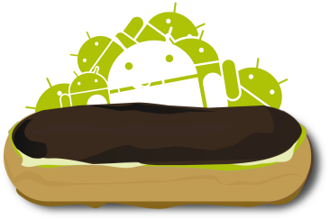





Android Versions So Far…
Donut
Android 1.6
Froyo
Android 2.2.x
Cupcake
Android 1.5
Eclair
Android 2.0/2.1
Gingerbread
Android 2.3.x
Ice Cream Sandwich
Android 4.0.x
KitKat
Android 4.4.x
Honeycomb
Android 3.x
Jelly Bean
Android 4.1.x
Lollipop
Android 5.0/5.1

Slide 14
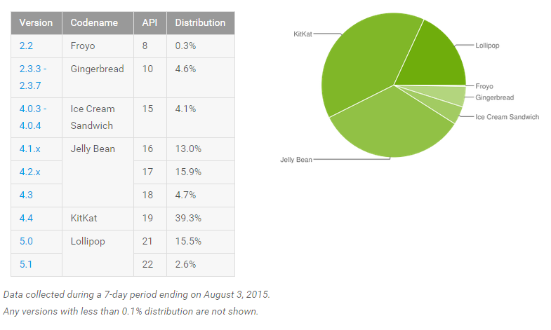
Distribution of Devices
http://developer.android.com/resources/dashboard/platform-versions.html

Slide 15
What is Google Android?
A software stack for mobile devices that includes
An operating system
Middleware
Key Applications
Uses Linux to provide core system services
Security
Memory management
Process management
Power management
Hardware drivers

Slide 16
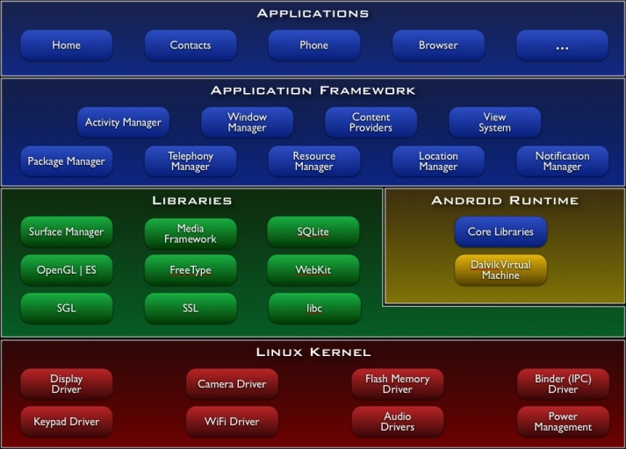
Android Architecture
More details at: http://developer.android.com/guide/basics/what-is-android.html
Notes:
The linux kernel 2.6 is the hardware abstraction layer (HAL) between the hardware and the android software stack.

Slide 17
Mobile Applications
What are they?
Any application that runs on a mobile device
Types
Web apps: run in a web browser
HTML, JavaScript, Flash, server-side components, etc.
Native: compiled binaries for the device
Often make use of web services

Slide 18
Android Apps
Built using Java and new SDK libraries
No support for some Java libraries like Swing & AWT
Java code compiled into Dalvik byte code (.dex)
Optimized for mobile devices (better memory management, battery utilization, etc.)
Dalvik VM runs .dex files

Slide 19
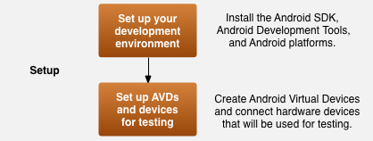

Development Process for an Android App

Slide 20
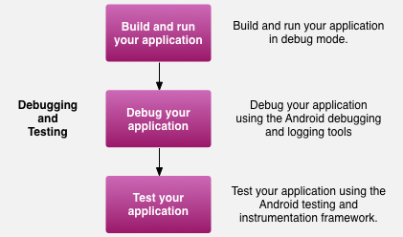
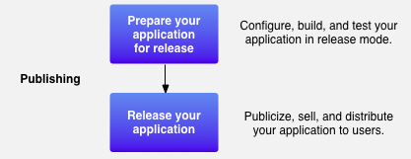
Development Process for an Android App

Slide 21
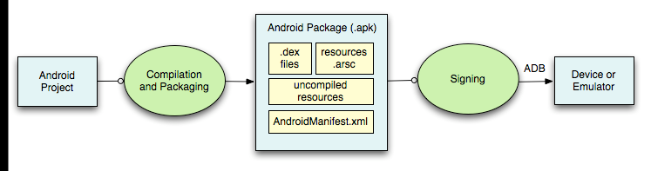
Building and Running
ADB is a client server program that connects clients on developer machine to devices/emulators to facilitate development.
An IDE like Eclipse handles this entire process for you.
Compiled resources
(xml files)
Android Debug Bridge
http://developer.android.com/guide/developing/building/index.html#detailed-build

Slide 22
Application are Boxed
By default, each app is run in its own Linux process
Process started when app’s code needs to be executed
Threads can be started to handle time-consuming operations
Each process has its own Dalvik VM
By default, each app is assigned unique Linux ID
Permissions are set so app’s files are only visible to that app

Slide 23
Android Design Philosophy
Applications should be:
Fast
Resource constraints: <200MB RAM, slow processor
Responsive
Apps must respond to user actions within 5 seconds
Secure
Apps declare permissions in manifest
Seamless
Usability is key, persist data, suspend services
Android kills processes in background as needed
Other design principles:
http://developer.android.com/design/index.html

Slide 24
Development Tools
Things needed to develop OpenGL for Android:
JDK 6+ (JRE alone is not sufficient)
http://www.oracle.com/technetwork/java/javase/downloads/index.html
Android SDK (Software Development Kit)
http://developer.android.com/sdk/index.html
Eclipse IDE (3.7.2 (Indigo) or greater)
http://www.eclipse.org/downloads/
ADT Plugin (Android Development Tools)
http://developer.android.com/sdk/installing/installing-adt.html
Android Device
Windows Users: need to install phone drivers

Slide 25
Android SDK
Once installed open the SDK Manager
Install the desired packages
Create an Android Virtual Device (AVD)

Slide 26
ADT Plugin
In Eclipse, go to Help -> Install New Software
Click ‘Add’ in top right
Enter:
Name: ADT Plugin
Location: https://dl-ssl.google.com/android/eclipse/
Click OK, then select ‘Developer Tools’, click Next
Click Next and then Finish
Afterwards, restart Eclipse
Specify SDK location

Slide 27
Project Components
src – your source code
gen – auto-generated code (usually just R.java)
libs – Included libraries
res – Resources
Drawables (like .png images)
Layouts
Values (like strings)
Menues
Manifest file

Slide 28
XML
Used to define some of the resources
Layouts (UI)
Strings
Manifest file
Shouldn’t usually have to edit it directly, Eclipse can do that for you
Preferred way of creating UIs
Separates the description of the layout from any actual code that controls it
Can easily take a UI from one platform to another

Slide 29
R Class
Auto-generated: you shouldn’t edit it
Contains IDs of the project resources
Enforces good software engineering
Use findViewById and Resources object to get access to the resources
Ex. Button b = (Button)findViewById(R.id.button1)
Ex. getResources().getString(R.string.hello));

Slide 30
Layouts
Eclipse has a great UI creator
Generates the XML for you
Composed of View objects
Can be specified for portrait and landscape mode
Use same file name, so can make completely different UIs for the orientations without modifying any code

Slide 31
Strings
In res/values
strings.xml
Application wide available strings
Promotes good software engineering
UI components made in the UI editor should have text defined in strings.xml
Strings are just one kind of ‘Value’ there are many others

Slide 32
Manifest File
Contains characteristics about your application
When have more than one Activity in app, NEED to specify it in manifest file
Go to graphical view of the manifest file
Add an Activity in the bottom right
Browse for the name of the activity
Need to specify Services and other components too
Also important to define permissions and external libraries, like Google Maps API

Slide 33
Android Programming Components
Activity
http://developer.android.com/guide/topics/fundamentals/activities.html
Service
http://developer.android.com/guide/topics/fundamentals/services.html
Content Providers
Broadcast Receivers

Slide 34
Activities
The basis of android applications
A single Activity defines a single viewable screen
Can have multiple per application
Each is a separate entity
They have a structured life cycle
Different events in their life happen either via the user touching buttons or programmatically

Slide 35
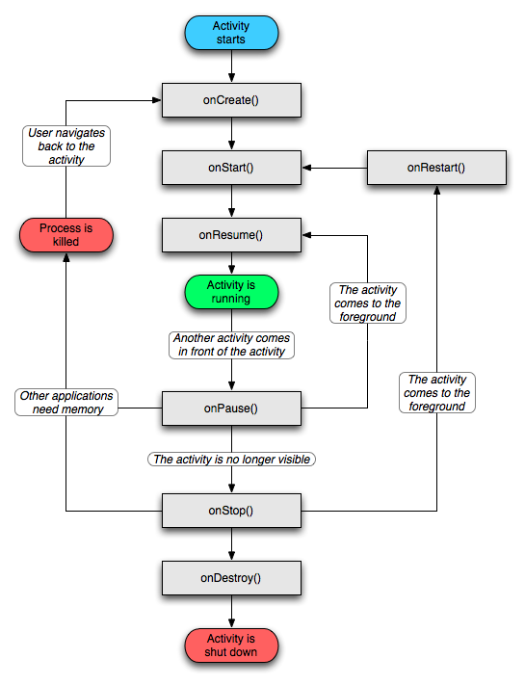
Activity Life Cycle

Slide 36
Services
Run in the background
Can continue even if Activity that started it dies
Should be used if something needs to be done while the user is not interacting with application
Can be bound to an application
In which case will terminate when all applications bound to it unbind
Allows multiple applications to communicate with it via a common interface
Needs to be declared in manifest file
Like Activities, has a structured life cycle

Slide 37
Running in Eclipse
Similar to launching a regular Java app, use the launch configurations
Specify an Android Application and create a new one
Specify activity to be run
Can select a manual option, so each time program is run, you are asked whether you want to use the actual phone or the emulator
Otherwise, it should be smart and use whichever one is available

Slide 38
USB Debugging
Should be enabled on phone to use developer features
In the main apps screen select Settings -> Applications -> Development -> USB debugging (it needs to be checked)

Slide 39
Android Debug Bridge
Used for a wide variety of developer tasks
Read from the log file
Show what android devices are available
Install android applications (.apk files)
In the ‘platform-tools’ directory of the main android sdk directory
Recommend putting this directory and the ‘tools’ directory on the system path
adb.exe

Slide 40
Debugging
Instead of using traditional System.out.println, use the Log class
Imported with android.util.Log
Multiple types of output (debug, warning, error, …)
Log.d(<tag>,<string>)
Can be read using logcat.
Print out the whole log, which auto-updates
adb logcat
Erase log
adb logcat –c
Filter output via tags
adb logcat <tag>:<msg type> *:S
can have multiple <tag>:<msg type> filters
<msg type> corresponds to debug, warning, error, etc.
If use Log.d(), then <msg type> = D
Reference
http://developer.android.com/guide/developing/debugging/debugging-log.html

Slide 41
References
Developer’s Guide
http://developer.android.com/guide/index.html
API Reference
http://developer.android.com/reference/packages.html

Slide 42

See you Next Lab

